Slide 1
Demogulations Final Project
Demogulations
Demographics +
Evaluations
R Package:
Assigning hyperparameters for ST-GPR
R Package:
Checking accuracy of survey microdata materials for GHDx

Slide 2

Evaluations and Primary Data Collection context
Evaluations team is OFTEN trying to evaluate effectiveness of specific health interventions.
OFTEN requires very specific data that doesn’t exist
Custom indicators
Custom locations
Custom timeframes
IHME conducts primary data collection in form of surveys.
IHME develops surveys, methods
Local field teams conduct fieldwork
IHME analyzes and owns data

Slide 3
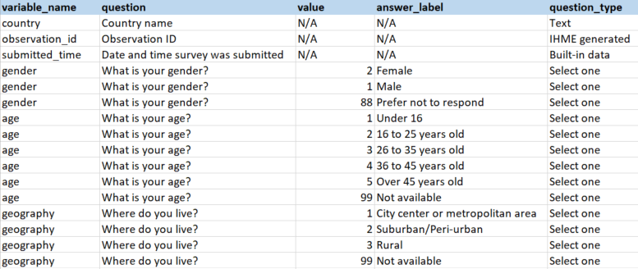
Global Health Data Exchange
Survey microdata published to the Global Health Data Exchange (GHDx)
requires materials formatted in a specific manner
Codebook is a key document to accompany the dataset
Original codebook format determined by data collection software and must be transformed, often by hand, to GHDx format.
Opportunity to introduce errors to the system
Final Project Objective: Develop a series of functions to check codebook-dataset pairings for IHME-collected survey microdata to ensure they are accurate.

Slide 4
Survey Microdata Checks – Pair 1
Consistency of variables between codebook and dataset
missing_from_data: identifies variables in codebook but not in data
missing_from_book: identifies variables in data but not in codebook
Inputs: A dataset and a codebook
Outputs:
If non-matching variables: list of variables missing from either codebook or dataset
If all variables match: message to console indicating all variables match.

Slide 5
Survey Microdata Checks – Pair 2
Consistency of question text, type within codebook variables
is_consistent_question: identifies variables with multiple question texts
is_consisten_type: identifies variables with multiple question types
Inputs: A codebook
Outputs:
If inconsistency: list of variable names with inconsistent question/type
If no inconsistency: message to console indicating all questions/types are consistent

Slide 6
Survey Microdata Checks – Pair 3
Missing question responses or labels
is_vartype_always_na: identifies variables where response/label is NOT always NA
is_vartype_ever_na : identifies variables where response/label is
Inputs: A codebook and a variable type
Outputs:
If unexpected missingness: list of variable names with unexpected missingness status
If expected missingness: message to console indicating all variables have missing/non-missing values

Slide 7
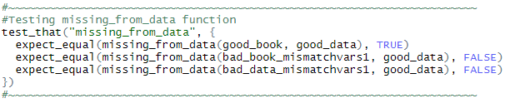
Testing
Package includes unit-tests for each function
Unit-testing achieved in 2 major steps
Defining “good” and “bad” datasets and codebooks
Different “bad” datasets fail different test
For each function, determine which tests should fail using different “good” and “bad” inputs

Slide 8
Areas for improvement
Additional test
E.g. All variable-value combinations in data are included in codebook
Reduced repetition
“missing_from_data/book” contain overlapping code. Could be combined into single function.
Greater flexibility
“is_vartype_always/ever_na” currently only identifies “NA” text strings
Report output
All output is printed to console for interactive use. Could be useful to run full report and develop Rmarkdown report with results.

Slide 9
hyperparameters: a hyperpackage for Hyperparameters
Data Density calculation and hyperparameter assignment for ST-GPR

Slide 10
Background
Sex Ratio at Birth Model:
The least intimidating demographics model
Linear mixed effects model
Assign hyperparameters
Spaciotemporal smoothing
Format for Gaussian Process Regression (GPR)
GPR
…..
HMS 520 Final Project:
I wanted to make something relevant to the SRB model
These steps are the outline for many models
5q0, 45q15, stillbirths
Functions written for one process may be used by the others.

Slide 11
Goals
Refactor: Create functions which can replicate Sex Ratio at Birth model code.
Extend: Make functions flexible enough to be used in other ST-GPR models in the Demographics pipeline.
Ensure Consistency: checks and tests ensure code functionality and consistent implementation

Slide 12
Package Data: Data Density Table (ddt)
Data Density | Zeta | Lambda | Beta | Scale
0 to 9 | 0.7 | 0.7 | 10 | 15
10 to 19 | 0.7 | 0.5 | 10 | 15
20 to 29 | 0.8 | 0.4 | 10 | 15
30 to 49 | 0.9 | 0.3 | 10 | 10
50 plus | 0.99 | 0.2 | 10 | 5
dt_density_tbl
Hyperparameters are assigned according to data density
Hardcoded in most scripts or read from file, only minor variation between processes
Benefits: centralized, understand modifications through reading function calls, Not staring at documentation or separate scripts

Slide 13
Functions: Modify Data Tables
mod_hyppar()
mod_hyppar(“lambda”, c(0.7,0.5,0.3, 0.1, 0.1))
mod_densities()
mod_densities(seq(0,48,12))
Data Density | zeta | lambda | beta | scale
0 to 9 | 0.7 | 0.7 | 10 | 15
10 to 19 | 0.7 | 0.5 | 10 | 15
20 to 29 | 0.8 | 0.4 | 10 | 15
30 to 49 | 0.9 | 0.3 | 10 | 10
50 plus | 0.99 | 0.2 | 10 | 5
Data Density
0 to 11
12 to 23
24 to 35
36 to 47
48 plus
lambda
0.7
0.5
0.3
0.1
0.1

Slide 14
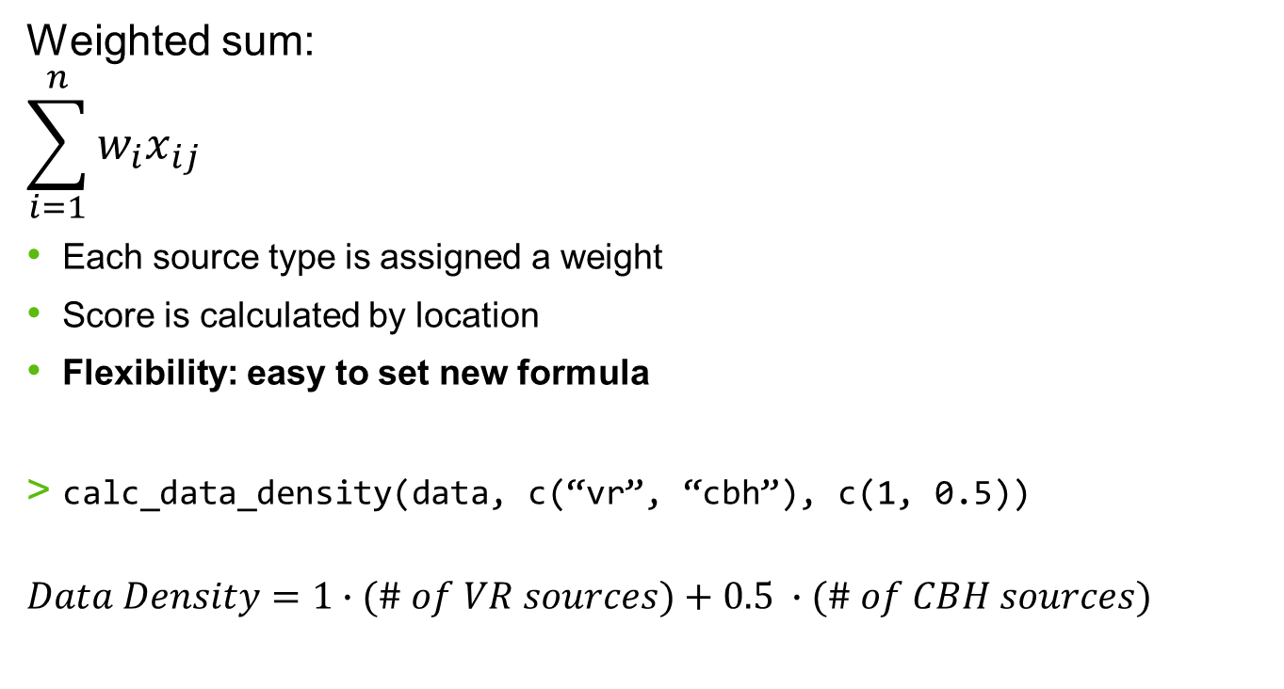
Function: calculate data density
Weighted sum:
$$\sum_{i=1}^{n}{w_{i}x_{ij}}$$
Each source type is assigned a weight
Score is calculated by location
Flexibility: easy to set new formula
calc_data_density(data, c(“vr”, “cbh”), c(1, 0.5))
$$Data Density=1∙(\# of VR sources)+0.5 ∙(\# of CBH sources)$$

Slide 15
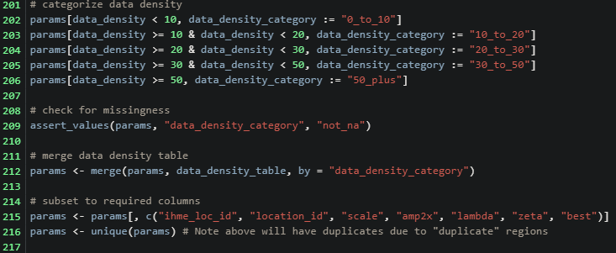
Function: Assign Hyperparameters
Assign hyppars to locations based on data density
Efficiency improvement:
Performs non-equi merge
Old method required assigning new column to join on before merging
Assign_hyppar(locs, dt_density_tbl)
Data Density | zeta | lambda | beta | scale
0 to 9 | 0.7 | 0.7 | 10 | 15
10 to 19 | 0.7 | 0.5 | 10 | 15
20 to 29 | 0.8 | 0.4 | 10 | 15
30 to 49 | 0.9 | 0.3 | 10 | 10
50 plus | 0.99 | 0.2 | 10 | 5

Slide 16
Reflection & Next Steps
Functions, with tweaking, are flexible enough to be used in all ST-GPR models
Exception: Adult mortality (45q15) data density calculation
Demographics code could improve with more centralized functions
Easier to test, ensure consistent implementation
Future functions: define_exceptions() and more.

